Slide 1
Web Engineering
Introduction to Javascript
Lecture 07

Slide 2
What is JavaScript?
A programming language specifically designed to work with Web browsers
It is designed to be used for developing small programs – called scripts – that can be embedded in HTML Web pages
JavaScript:
  Is an interpreted language
  Supports event-driven programming
  Is object-based language

Slide 3
HTML
CSS
JavaScript
markup language
style sheet language
programming language
content
presentation
behavior

Slide 4
Advantages of Client-Side Scripting
Reduced server load as it does not have to send messages to the user’s browser about missing or incorrect data
Reduced network traffic as the form’s data is sent only once instead of many to’s and fro’s

Slide 5
Case Sensitivity
HTML is not case sensitive. The following mean the same to the browser:
  <HTML> -- <html>
  <Html> -- <htMl>
JavaScript is case sensitive. Only the first of the following will result in the desired function – the rest will generate an error or some other undesirable event:
  onMouseClick -- OnMouseClick
  onmouseclick -- ONMOUSECLICK
alert(“hello world”);
Alert(“hello world”);

Slide 6
Referring to a Property
dot
objectName.propertyName
Examples:
window.width
button.value

Slide 7
A few more methods associated with the “window” object
alert()
confirm()
prompt()
close()
open()
focus()
blur()
setTimeOut()
setInterval()

Slide 8
Retrieving an element by ID
var myElement = document.getElementById(“abc”);
html
head
body
title
h1
p
ul id =“abc”
li
li
li

Slide 9
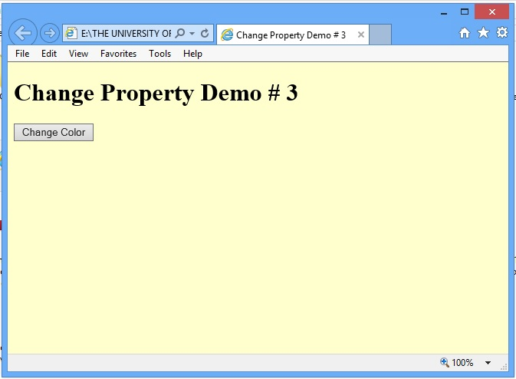

Slide 10
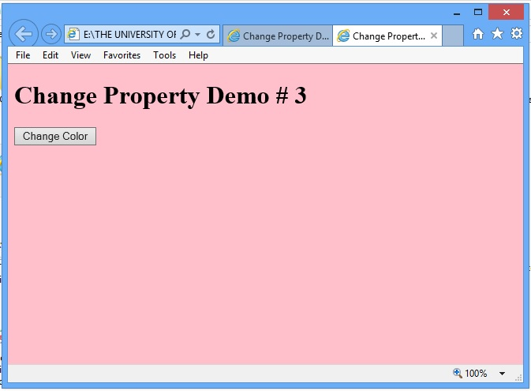

Slide 11
The main code segment that goes between the <SCRIPT>, </SCRIPT> tags in the HEAD:
function changeBgcolor() {
window.document.bgColor = “pink”;
}
The JavaScript code included as an attribute of the “Change Color” button:
onMouseOver=“changeBgcolor()”
new value
property

Slide 12
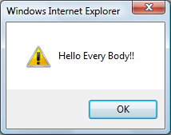
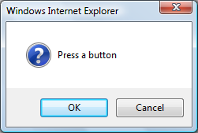
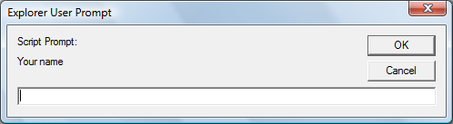
Popup Boxes
Alert Box
window.alert(“Hello Every body!!");
Confirm Box
window.confirm("Press a button");
Prompt Box
window.prompt(“Your name","")

Slide 13
JavaScript Data Types
Unlike in C, C++ and Java, there are no explicit data types in JavaScript
Nevertheless, it recognizes & distinguishes among the following types of values:
  Numbers, e.g., 23, 4.3, -230, 4.4e-24
  Booleans, e.g., true, false
  Strings, e.g., “hello”, “What’s the time?”
  Undefined

Slide 14
DOM
<script>
let btn = document.getElementById("hideBtn");
let heading = document.getElementById("heading");
function hideElement() {
heading.style.display = "none"; }
btn.onclick = hideElement;
</script>
<h2 id="heading">Hello, this is a heading!</h2>
<button id="hideBtn">Hide Heading</button>

Slide 15
Variables
Variables give us the ability to manipulate data through reference instead of actual value
Variables are names assigned to values
Variables are containers that hold values (Example: Hotel guest name, Guest room no.)
Generally, the value of a variable varies during code execution (that is why the term “variable”!)

Slide 16
Example
With Variable
Without Variable
x is a variable
5 lines of code replacing 5 lines of code!
Why u
se variables?
x = 1;
while (x < 6) {
document.write (x);
x = x + 1;
}
document.write (“1”); document.write (“2”); document.write (“3”); document.write (“4”); document.write (“5”);

Slide 17
Declaring Variables
Many languages require that a variable be declared (defined) before it is first used
JavaScript allows variable declaration, it does not require it
Declaring Variables –
var is function-scoped or globally-scoped. If declared inside a function, it's local to that function. If declared outside any function, it's global.
let is block-scoped. Its scope is limited to the block (e.g., within curly braces {})
const is also block-scoped, similar to let const variables cannot be reassigned
  var height
  let name, address, const phoneNumber
console.log(typeof name);

Slide 18
Identifiers
Identifiers are names used by JavaScript to refer to variables ( as well as objects, properties, methods, and functions!)
An identifier must begin with an alphabetical character (a-z or A-Z) or the underscore “_” character
Subsequent characters can be an alphabetical (a-z or A-B) or numeric character (0-9) or an underscore
Don’t not name variables with keywords like While
Wrong
1stStreet
number One
5
test@gmail
Right
Street1
numberOne

Slide 19
JavaScript Operators
Operators operate on operands to achieve the desired results
JavaScript has numerous operators, classified in many categories. We will look at only a few of them belonging to the following categories:
  Assignment operators -- Arithmetic operators
  Comparison operators -- String operators
  Logical operators
We’ll look at a few more during future lectures, but understand that there are many more. Even you text book does not cover all of them!

Slide 20
Example
if ( x != 0 )
result = y / x;
else
result = “not defined”;

Slide 21
Logical Operators
Operate on Boolean expressions or variables
The “AND (&&)” Logical Operator
if ( (pitch == “hard”) && (bowler == “fast”) )
myStatus = “Pulled muscle”;
The value of the variable myStatus will be set to “Pulled muscle” if both
a && b AND True if both are true
a || b OR True of either or both are true
!a NOT True if a is false
of the conditions are true

Slide 22
Example
if ( x || y )
document.write (“Either or both are true”);
else
document.write (“Both are false”);

Slide 23
if … else: Example 6
if ( grade == “A” )
points = 4.0 ;
else {
if ( grade == “B” )
points = 3.0 ;
else {
if ( grade == “C” )
points = 2.0 ;
else {
if ( grade == “D” )
points = 1.0 ;
else
points = 0.0 ;
}
}
}

Slide 24
switch: Example 1
switch ( grade ) {
case “A” :
points = 4.0 ;
break ;
case “B” :
points = 3.0 ;
break ;
case “C” :
points = 2.0 ;
break ;
case “D” :
points = 1.0 ;
break ;
default :
points = 0.0 ;
}
A colon following the case label is required
The expression enclosed in parentheses is evaluated and matched with case labels
This is a case label
This ‘break’ statement is the exit point
The ‘default’ statement acts like the ‘else’ clause in the ‘if…else’ structure

Slide 25
for: Example
for ( x = 99 ; x < 6000 ; x = x + 1 ) {
document.write ( x ) ;
}
=============
for ( x = 6000 ; x > 0 ; x = x - 1 )
{
document.write ( x ) ;
}
How many iterations would this ‘for’ loop run for?

Slide 26
student = new Array( 4 ) ; //array declaration
values = new Array(3); {1 ,2 ,3}
student[ 0 ] = values;
student[ 1 ] = “Waqar” ;
student[ 2 ] = “Saqlain” ;
student[ 3 ] = “Daanish” ;
Student[0][2]
for ( x = 0 ; x < 4 ; x = x + 1 ) {
document.write( student[ x ] ) ;
}
Can you see the advantage of using arrays along with the ‘for’ loop?

Slide 27
Arrays in JavaScript
In JavaScript, arrays are implemented in the form of the ‘Array’ object
The key property of the ‘Array’ object is ‘length’, i.e the number of elements in an array
Two of the key ‘Array’ methods are:
  reverse( )
  sort( )
Elements of an array can be of any type; you can even have an array containing other arrays

Slide 28
Lists
Lists in JavaScript are typically represented using arrays. You can display them dynamically on webpages using DOM manipulation.
let cities = ["Karachi", "Lahore", "Islamabad"];
cities.push("Quetta");
document.write(cities);
Using Loop
let students = ["Ali", "Sara", "Usman", "Fatima"];
students.forEach(function(name, index) {
console.log(`${index + 1}. ${name}`);
});

Slide 29
let scores = [85, 60, 92, 78, 70];
scores.sort(function(a, b){ return a - b }); // ascending order
console.log("Ascending:", scores);
scores.reverse(); // descending
console.log("Descending:", scores);
Filter
let ages = [12, 18, 22, 15, 30, 17];
let adults = ages.filter(function(age) {
return age >= 18;
});
console.log("Adults:", adults);

